Slide 1
THE CINCINNATI SISTER CITIES (INDIA)
PRESENTS
INDIAN FILM FESTIVAL OF
CINCINNATI
“Engage Diversity Through Film”
SEPT 5-14 2019
At Cincinnati Art Musuem
Esquire & Kenwood Theatres
SPONSOR BENEFITS 2019

Slide 5
INDIAN
FILM FESTIVAL
CINCINATI
&
OHIO SEPT 5-12

Slide 6
INDIAN
FILM FESTIVAL
CINCINNATI
&
OHIO SEPT 5-12

Slide 7
INDIAN
FILM FESTIVAL
CINCINNATI
&
OHIO SEPT 5-12

Slide 8
INDIAN
FILM FESTIVAL
CINCINN
&
OHIO SEPT 5-1

Slide 9
&
OHIO

Slide 11
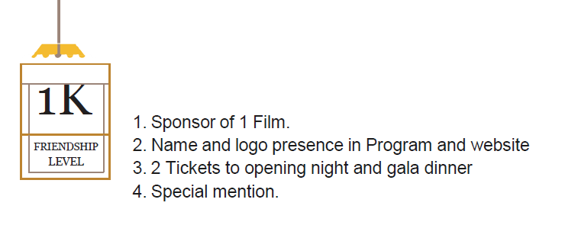

Slide 12
