Slide 1
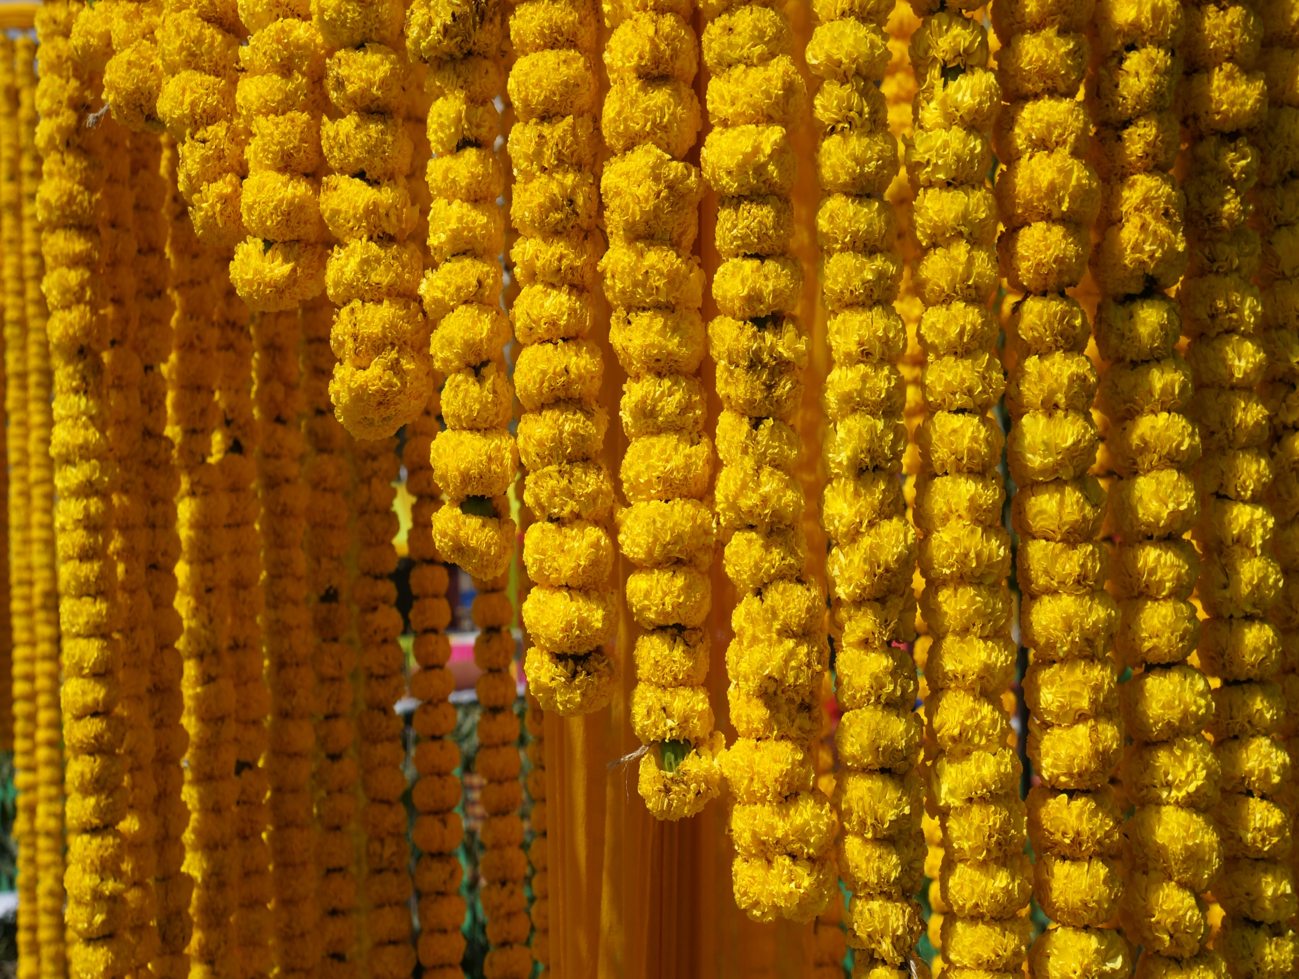
INDIA
Youth Ambassador program

Slide 3
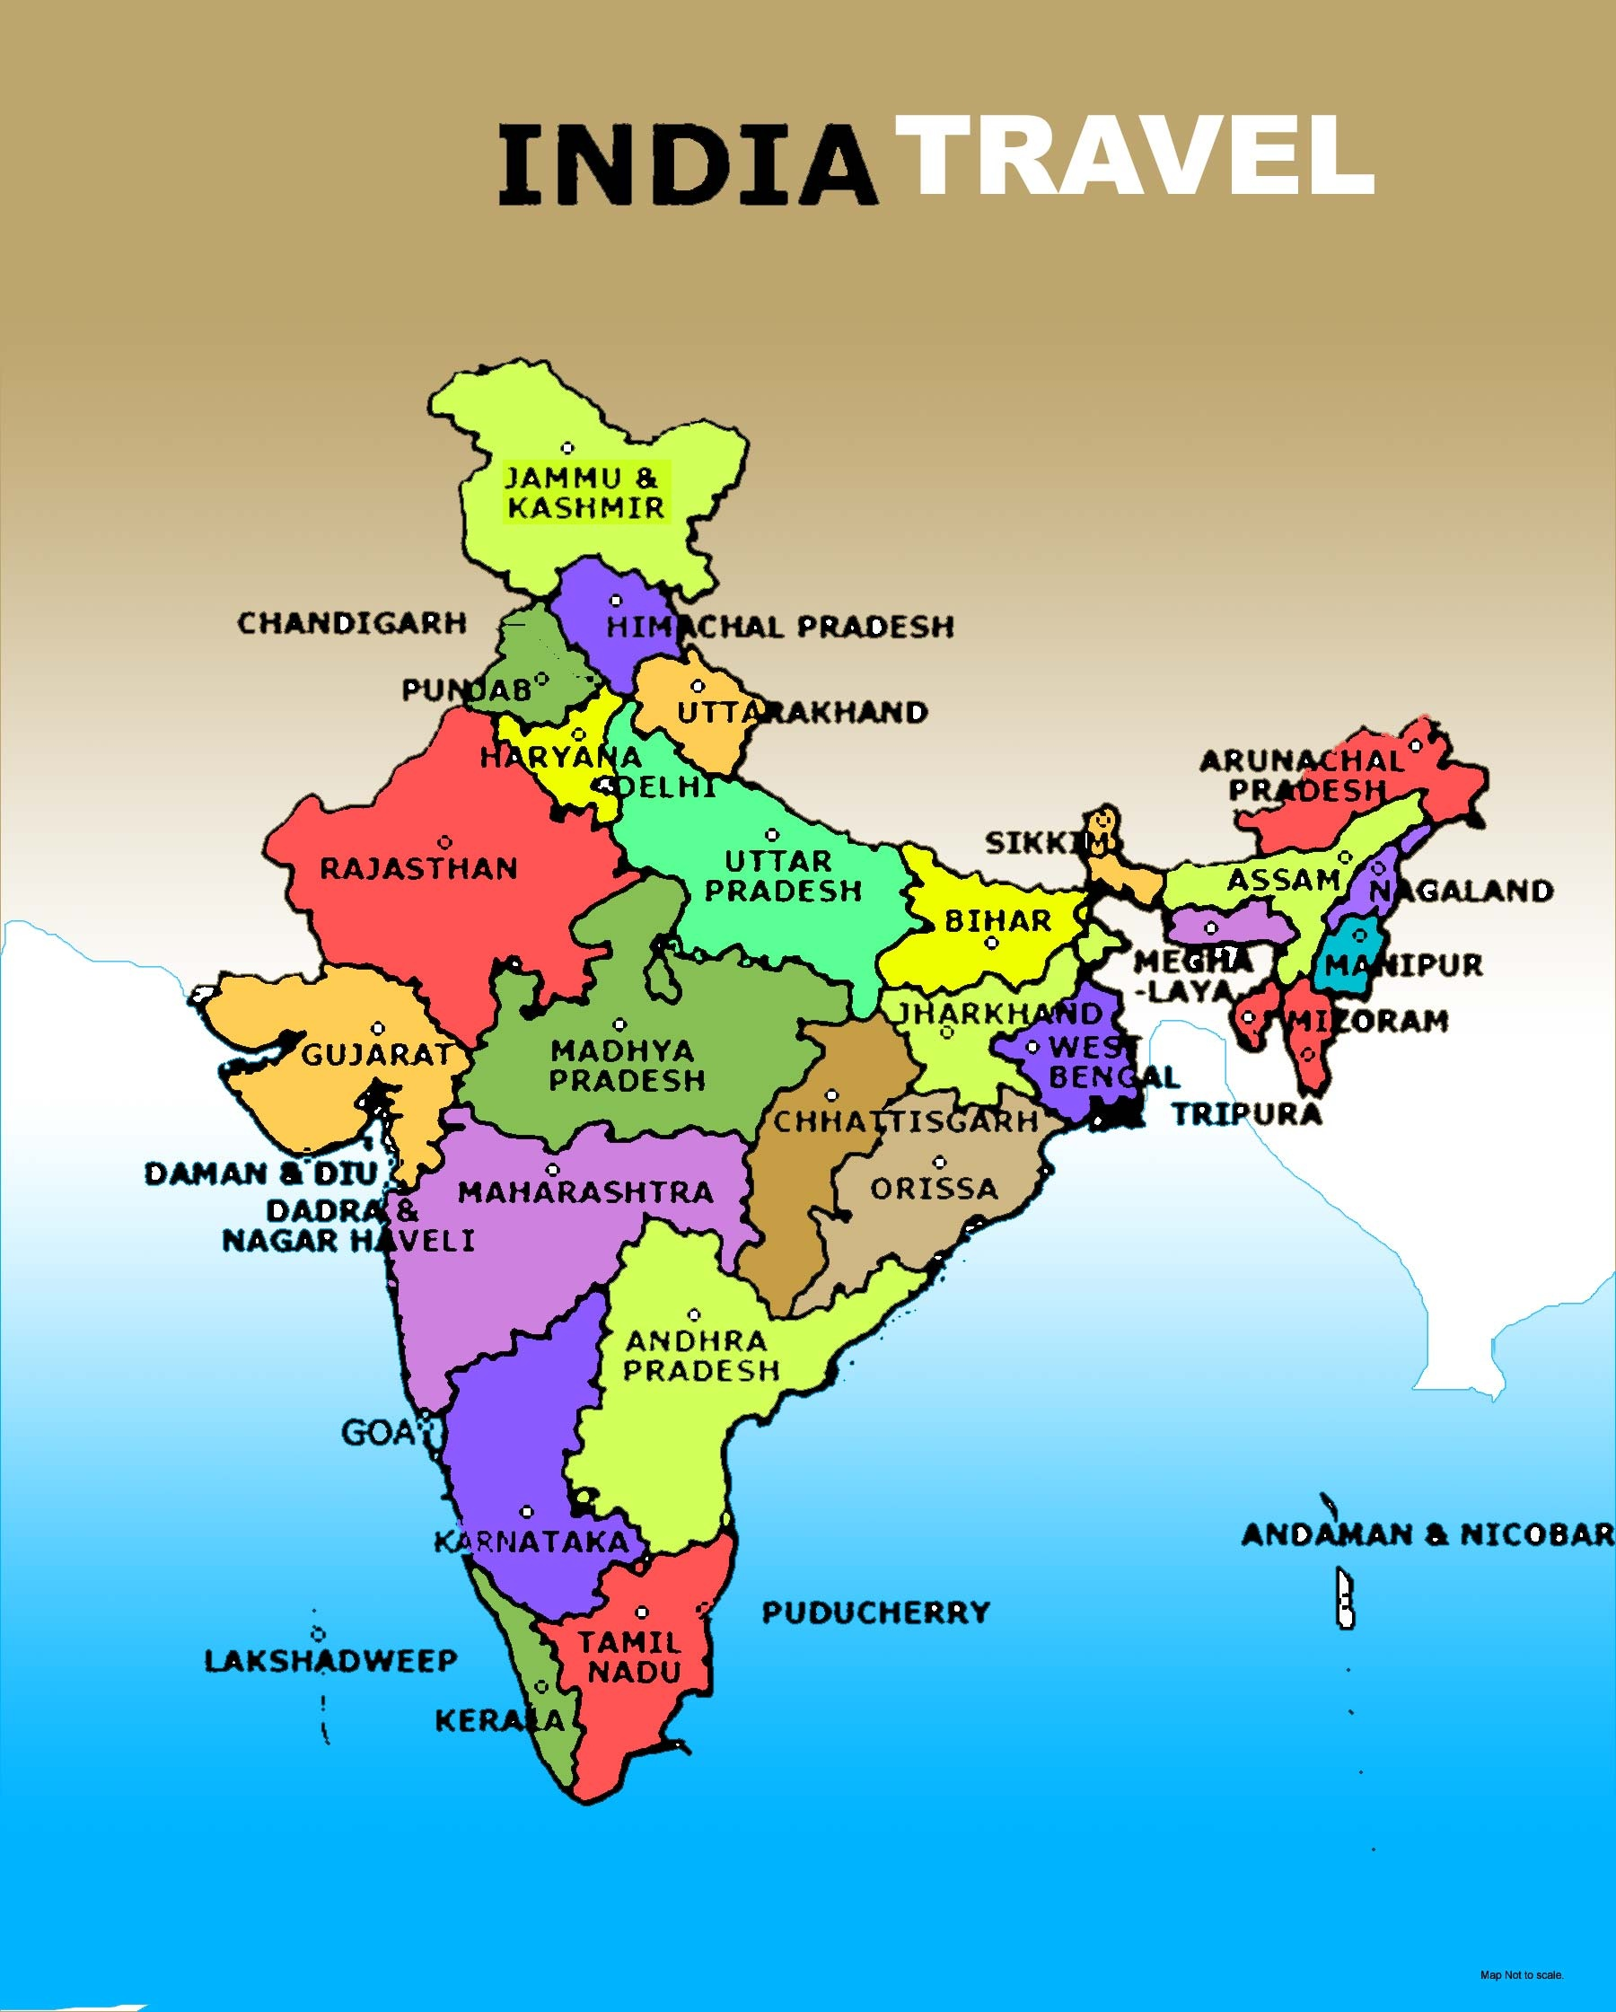
2017

Slide 4
Our Goal
To have students have a safe trip filled with fun and learning.
Number of students : 15
Ratio of Chaperones to students 1:7
Cost of program $2900 Cities we will visit: Bangalore, Mysore, Coorg.
Time 2 weeks June 4-June 18

Slide 5
Proposed activities.
History: Visits to BC, 10-1500’s and Modern sites.
Science: Visits to schools,
factories, plantations and game sanctuary
Social: Visit to host families
Fun: Go on nature walks, visit a game sanctuary, engage in a leadership rope course.

Slide 6
Tentative Agenda
All dates will be communicated to you.
Sign up by Dec 8.
Jan 15. Last date to confirm and first payment for ticket. (approx. $1800)
Monday March 21stFirst meeting (meeting location most likely at the school)
Monday April 11Th Culture of India
Monday April 18th History of India
Monday May 9th Trip details and Parent meeting.

Slide 7
Health Must Do’s
Pre –departure
Visit your doctor check on shots and immunizations.
In India
Bottled water will be provided to you
Bottled water at all times even to brush your teeth.
Avoid ice, cold drinks/cold food/exposed raw fruit and vegetables (no salads)
Your stomach and system takes a little time getting used to different water.

Slide 8
Sleep well.
Carry Mosquito repellent so you can spray your clothes and exposed body parts.
Drink plenty of water if you are taking any medications
Inform us of any allergies or medical conditions.

Slide 9
Pre-departure. Let your bank know you are travelling. You can use credit cards and ATMs.
In India. Money: Exchange money at the airport, Banks or exchange offices only. Do not give your money to newly made friends and acquaintances.

Slide 10
Safety
Health: Make sure you inform us if you are taking any medicines
Inform us of Allergies.
Have a small first aid kit with band aids etc.
Belongings: Keep your bags locked at all times hotel room included. Carry nothing expensive. No jewelry expensive watches etc.

Slide 11
Alcohol Policy.
Alcohol forbidden.
Absolutely forbidden to drink in hotel rooms
No drugs will be tolerated.

Slide 12
Schedule: Be flexible! Be punctual! Follow directions ! Use common sense! Look out for each other!
No activity is done alone, You will always be with chaperones and a buddy from the school

Slide 13
Things to get used to !
People dress differently.
People may look different to you. They may stare or make conversation.
Traffic is intense.
Drivers don’t keep their lanes.
You will see a lot more scooters and motorbikes.
Cars are smaller.
There are numerous mom and pop shops
Folks don’t line up like we do, they usually crowd around.
Personal space is smaller.
People don’t hug unless they are buddies. They shake hands and say “How are you?” or fold their hands in front ( like when you pray) and they say “Namaste.”
You never drink water out of a tap or faucet. Ask for purified water.
You are always respectful of adults.

Slide 14
Americans in Local dress at a wedding

Slide 15
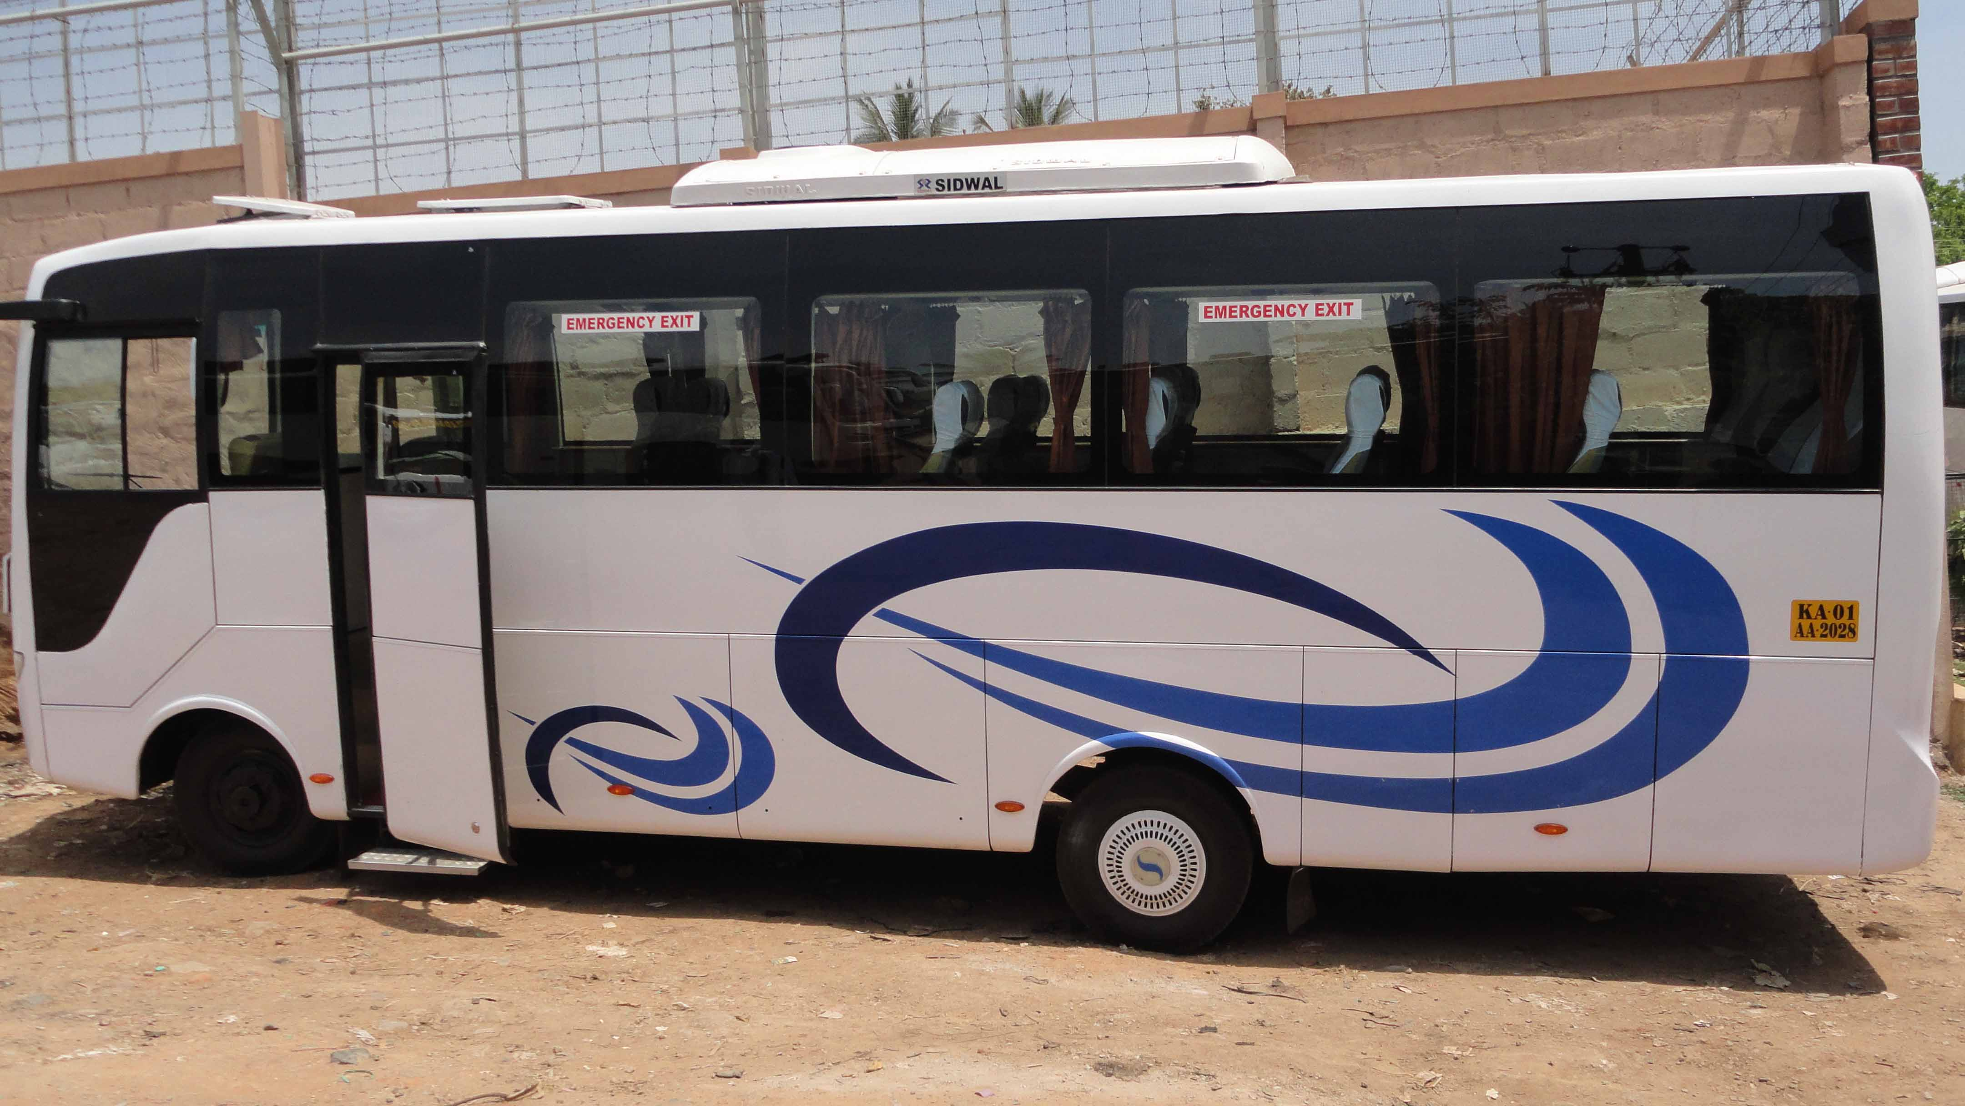
You will travel in a vehicle like this locally.

Slide 16
Students in the bus

Slide 17
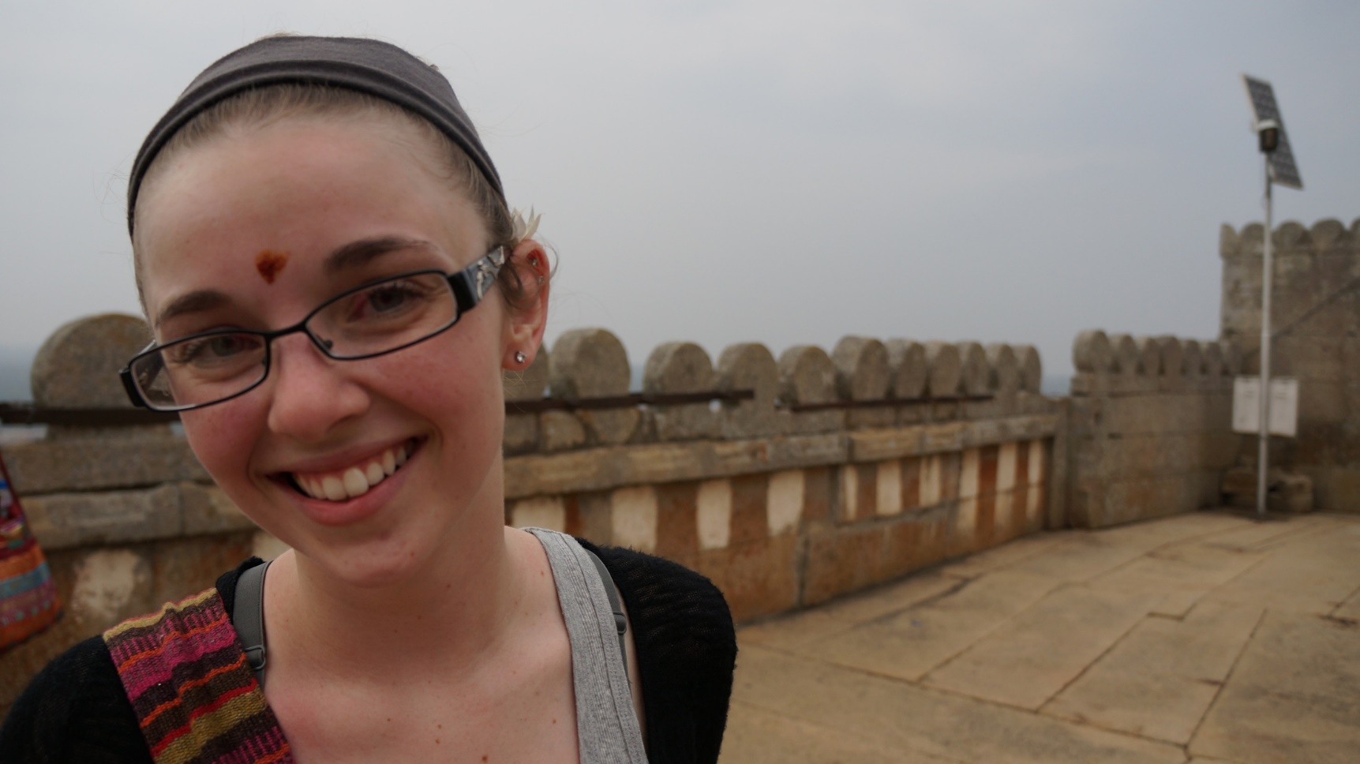
At a historic BC site on the way to Mysore

Slide 18
The Mysore Palace.

Slide 19
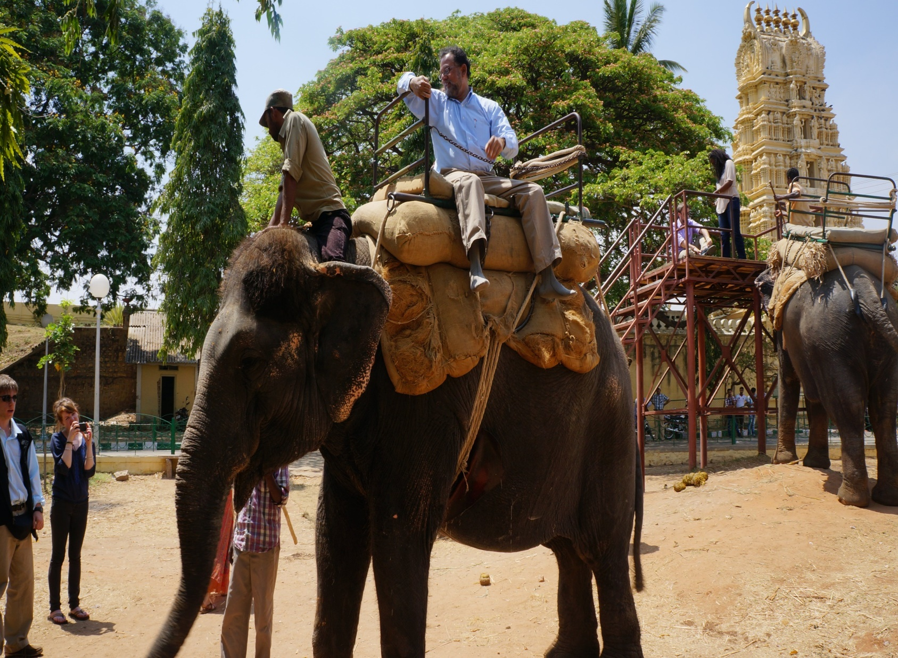
Riding a palace elephant

Slide 20
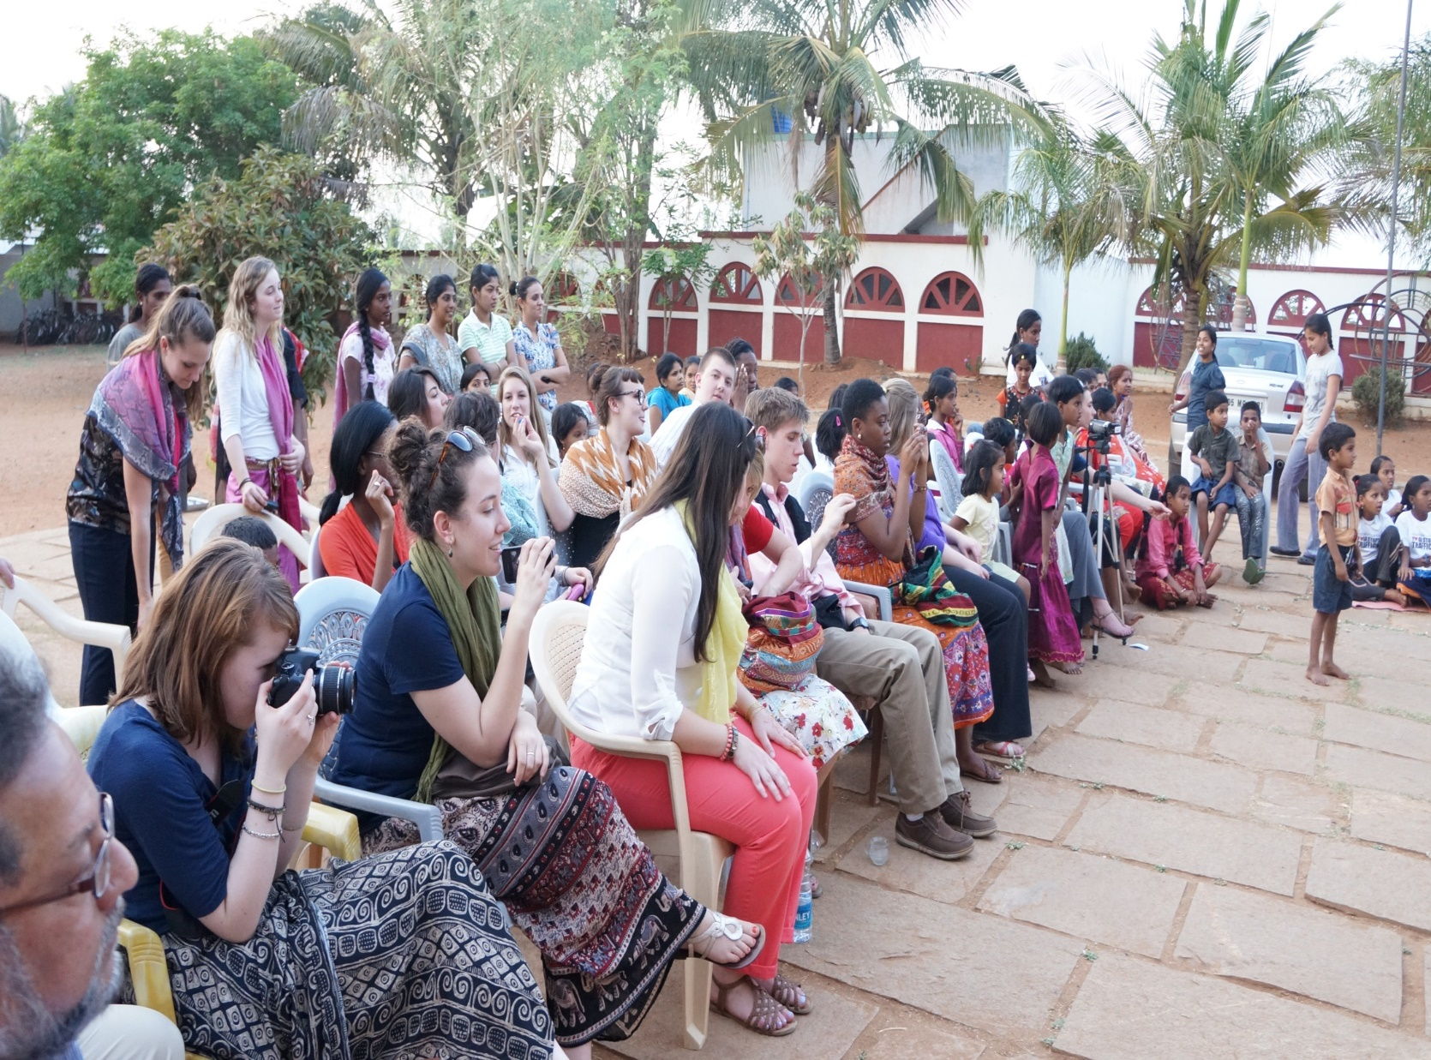
Service Learning at Odanadi.

Slide 21
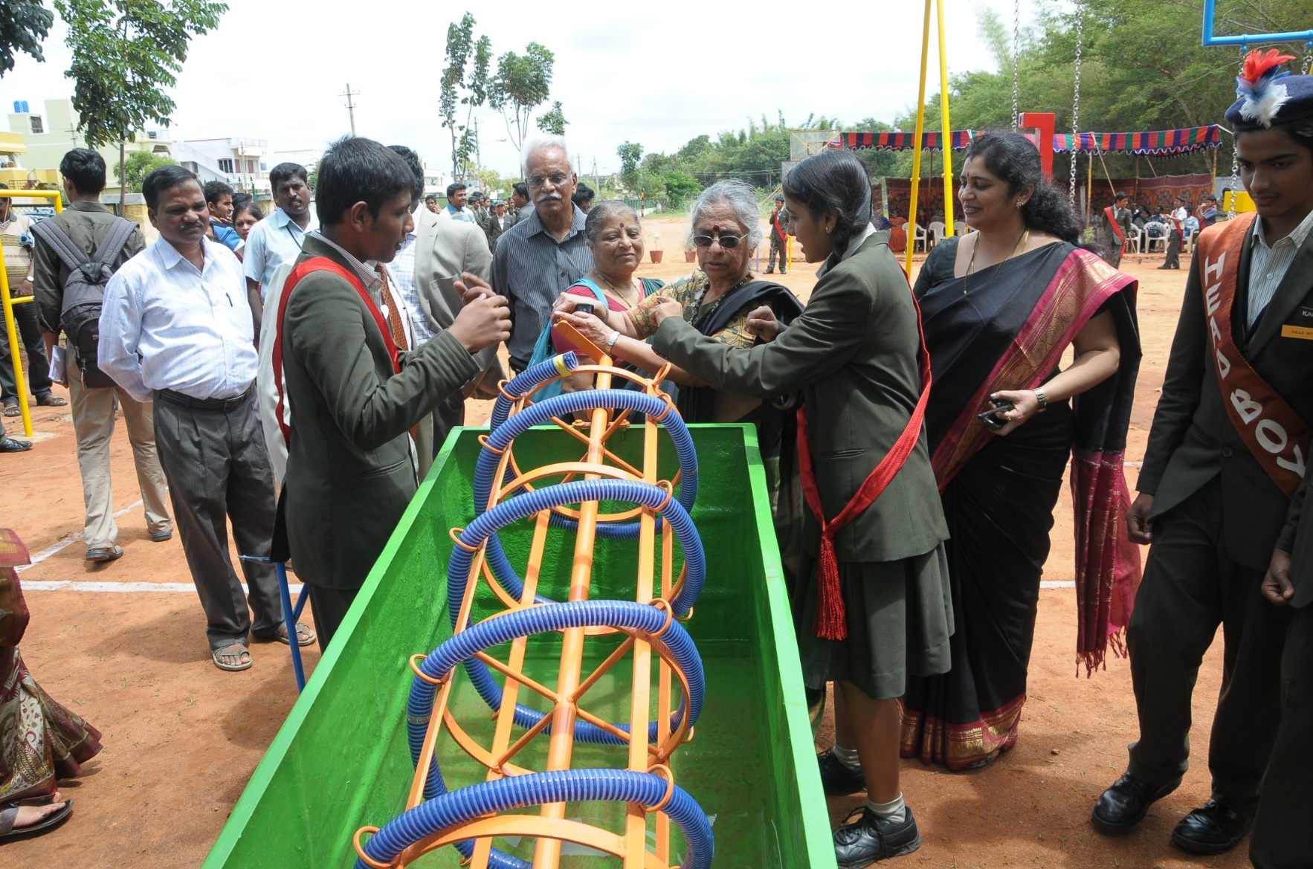
Kautilya school, The interactive science playground

Slide 22
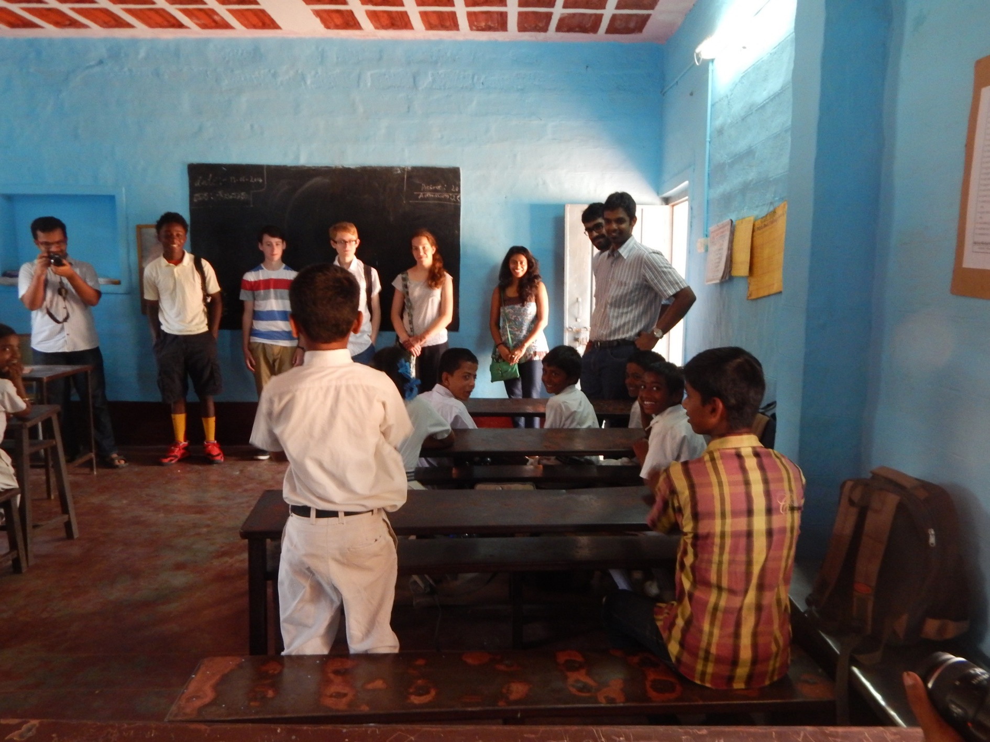
Service learning at a village school

Slide 23
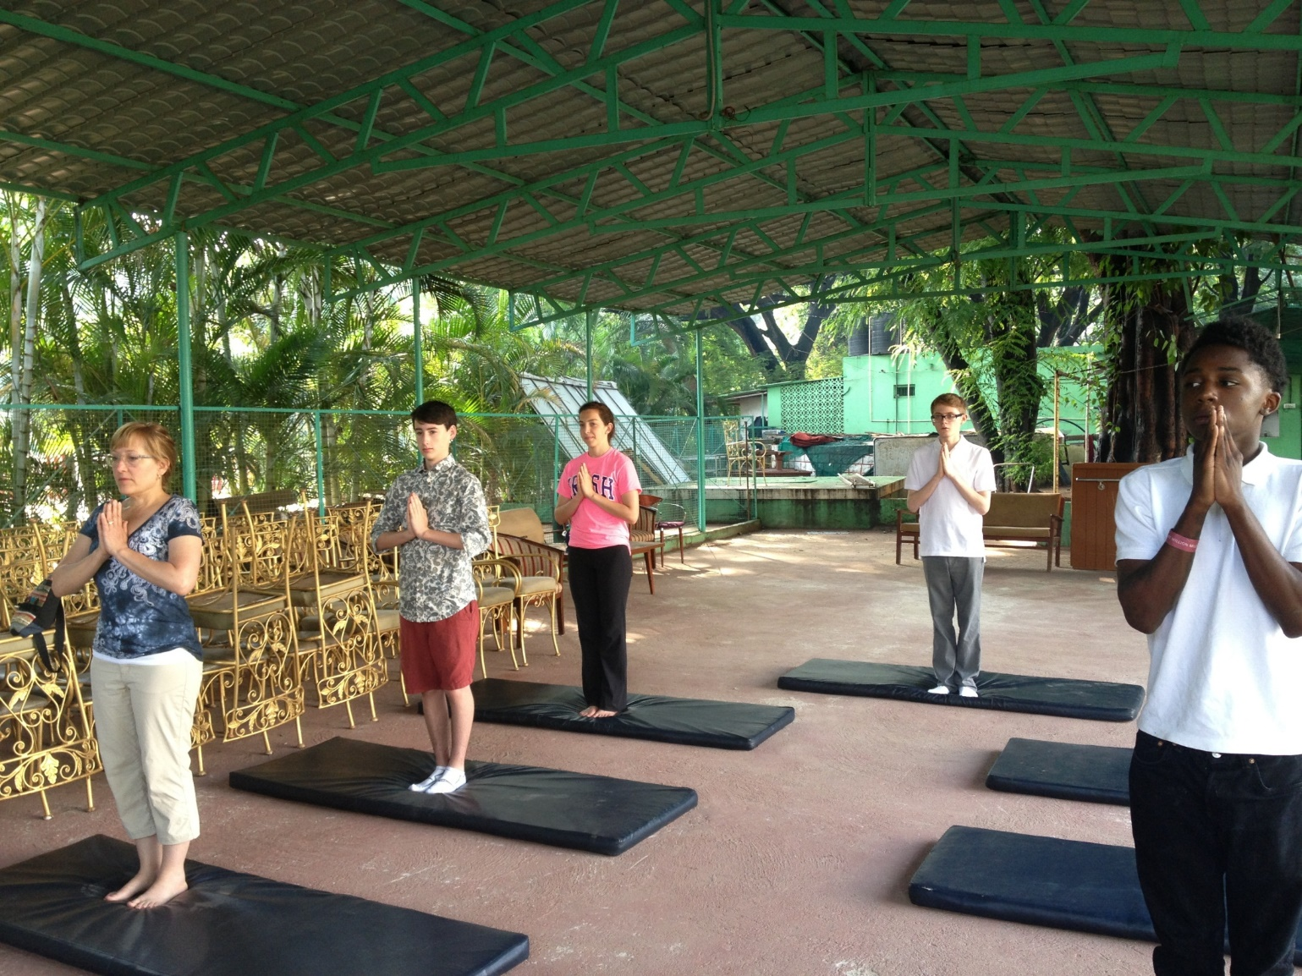
Mysore is the home of Yoga.

Slide 24
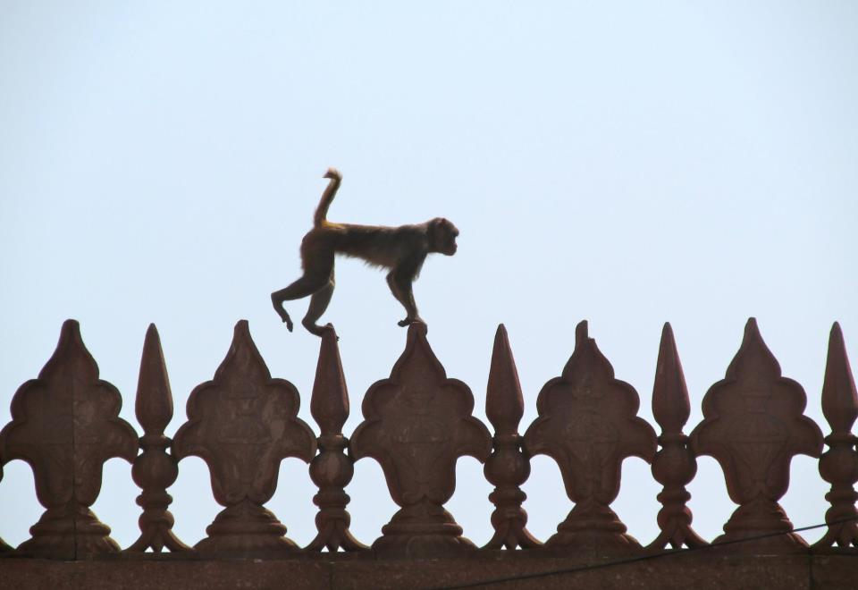
Monkeys!

Slide 25
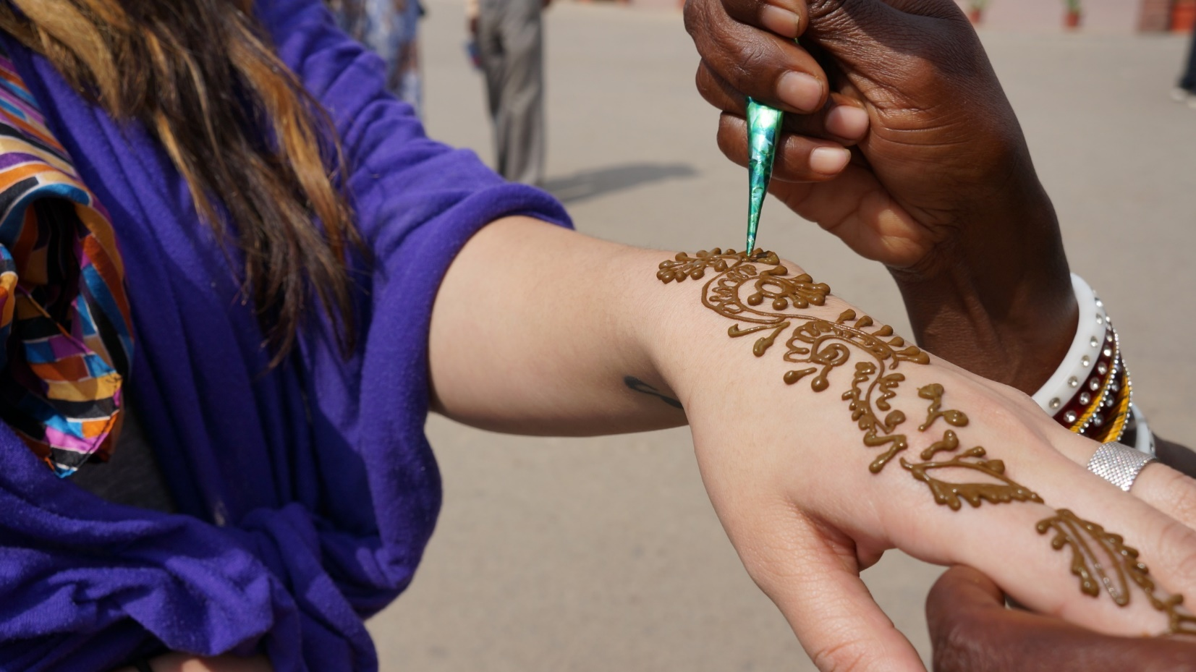
Henna

Slide 26
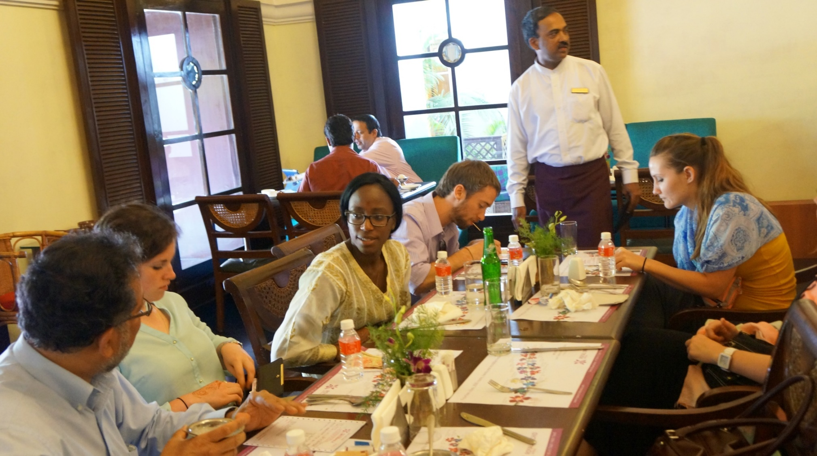
Lunch!

Slide 27
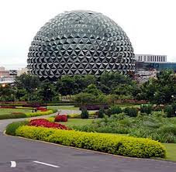
Infosys campus.

Slide 28
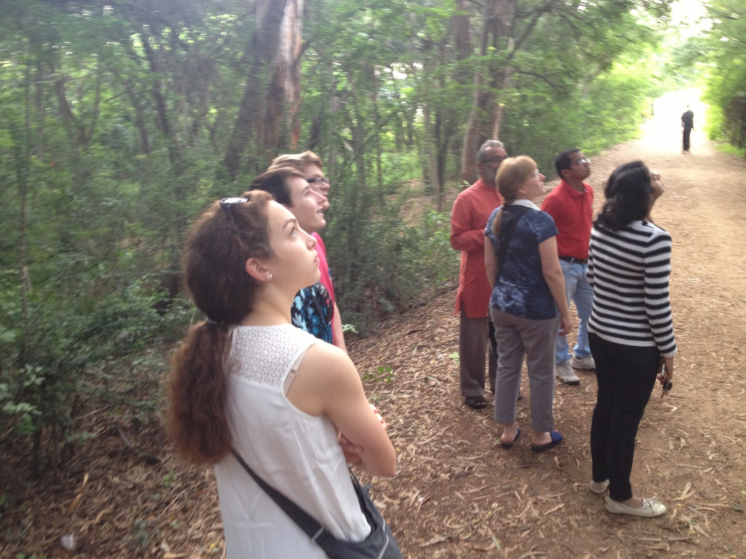
Nature walk

Slide 29
Travel to Coorg from Mysore.

Slide 30
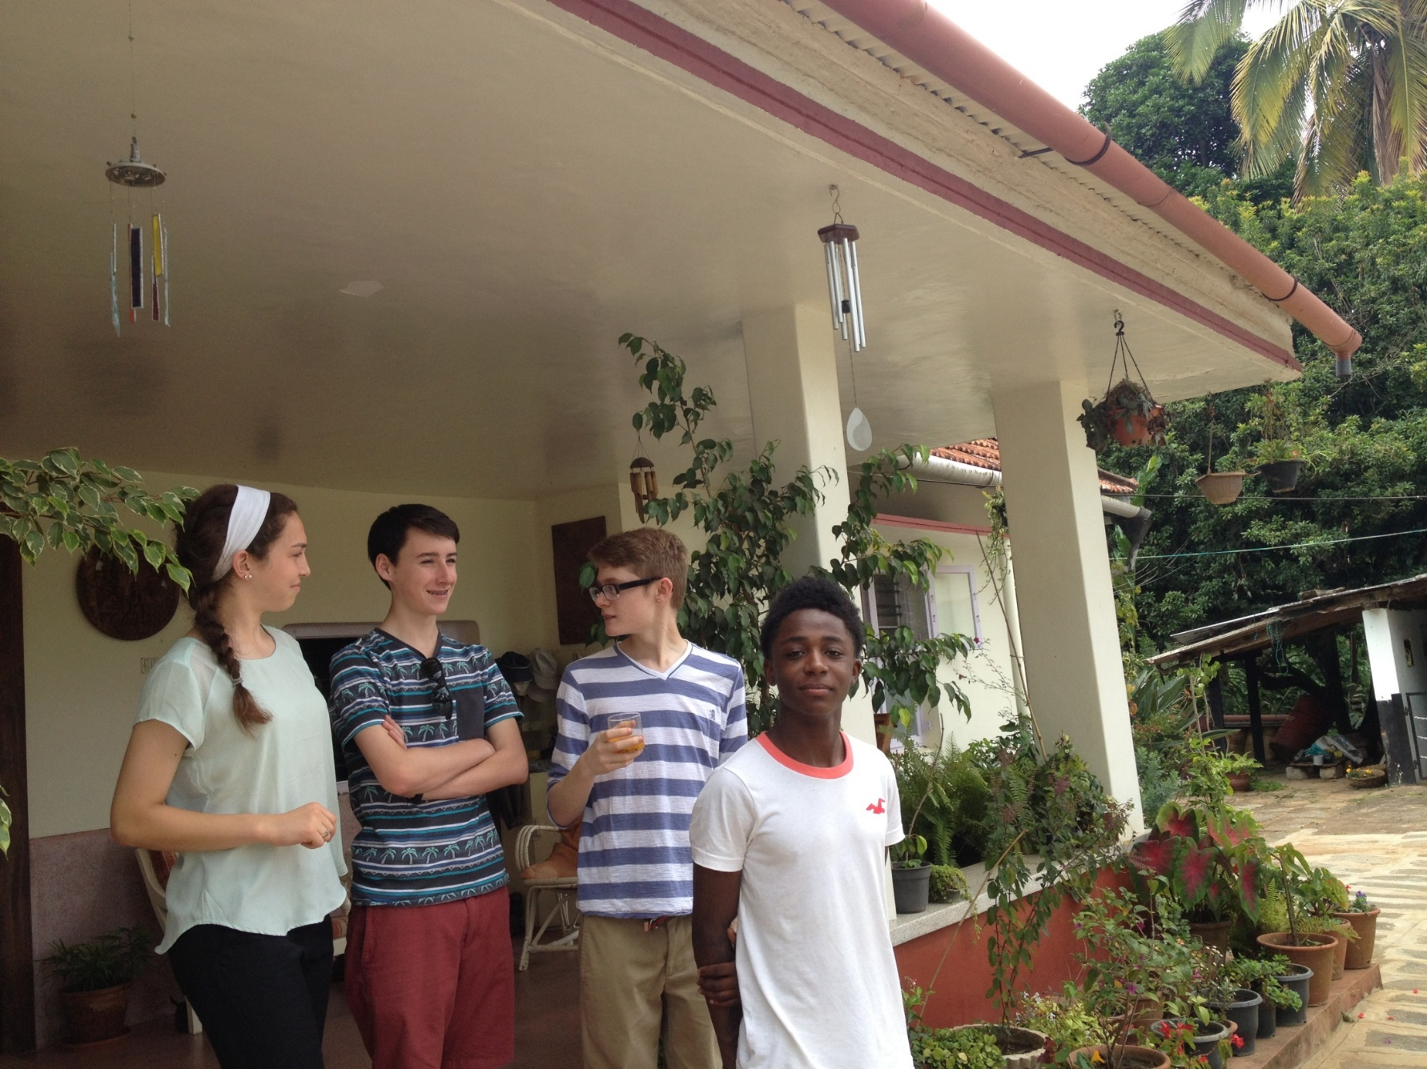
Visiting an Indian plantation Home in Coorg

Slide 31
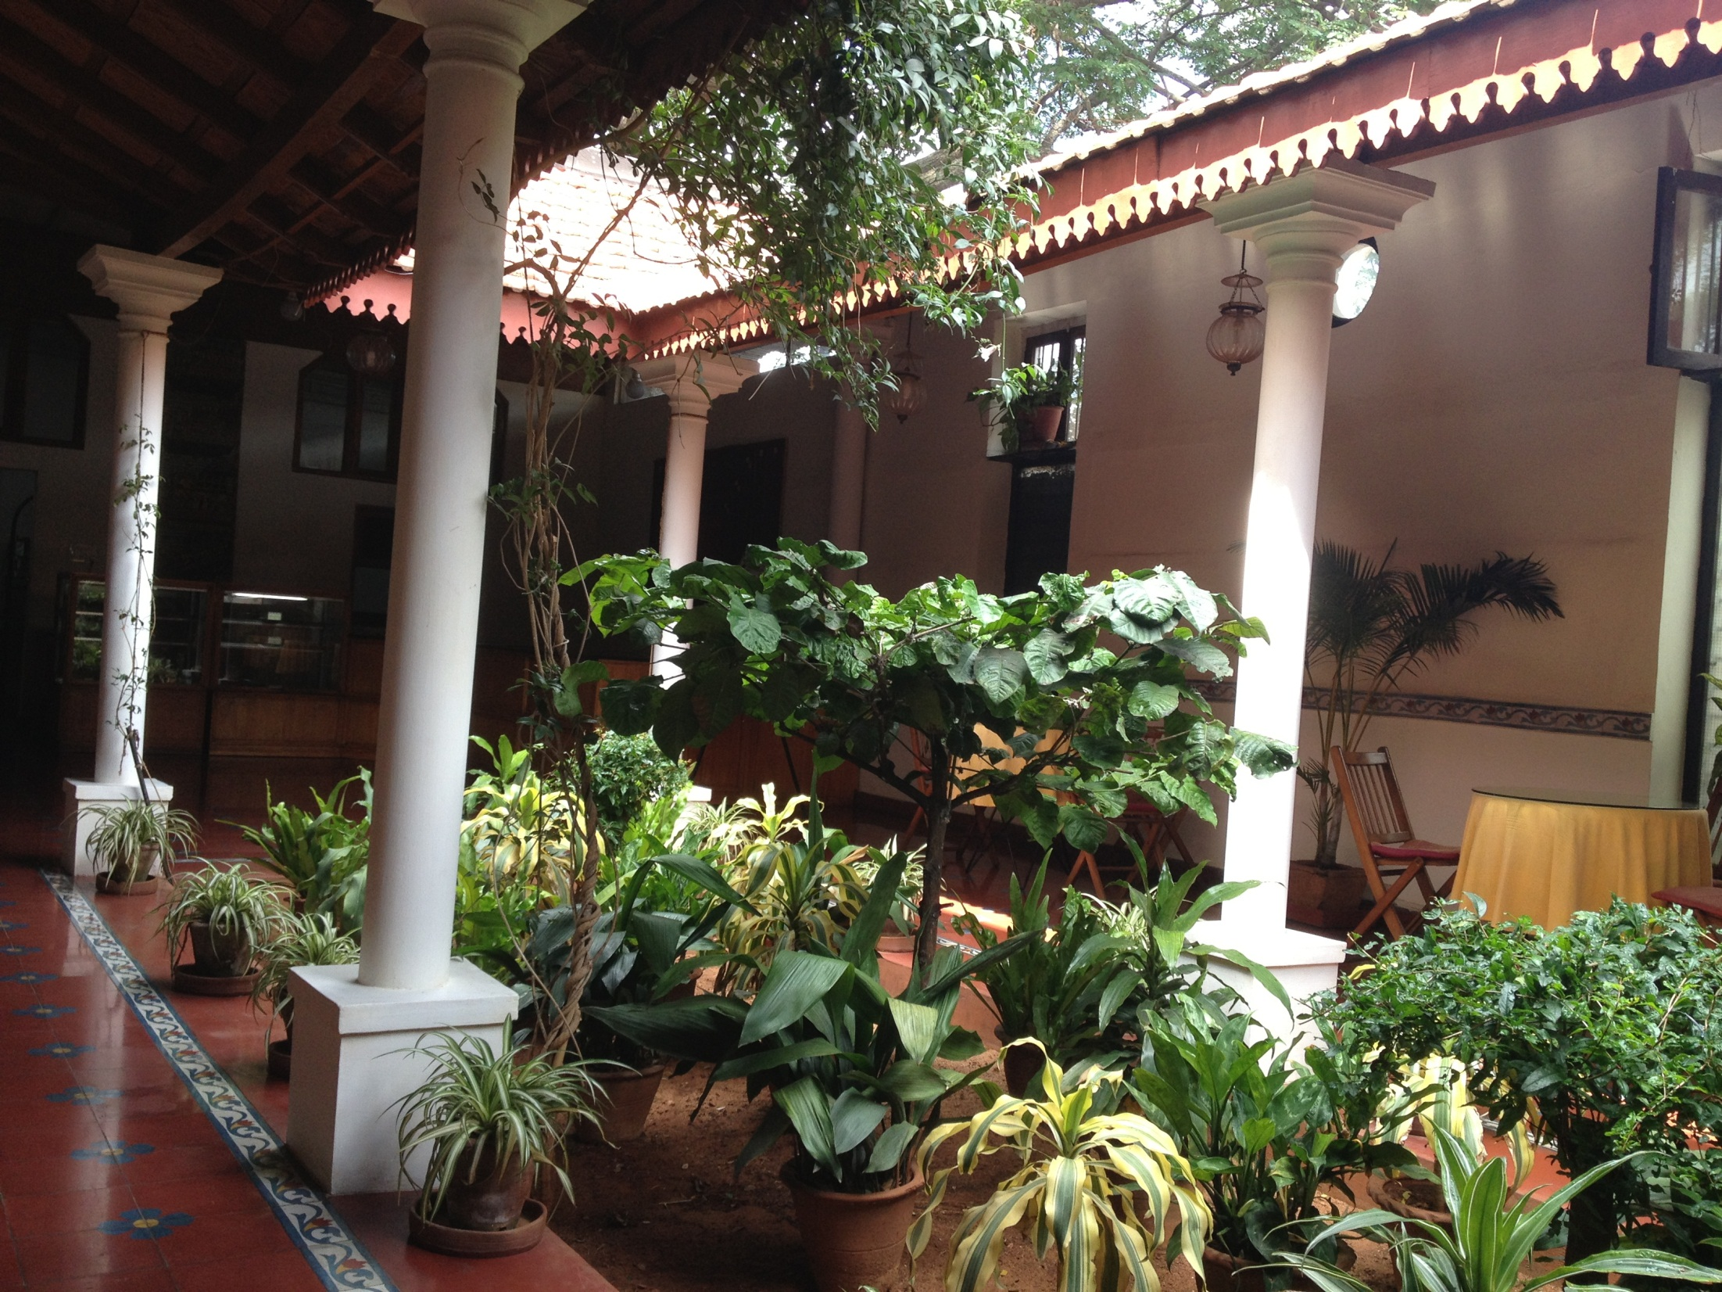

Slide 32
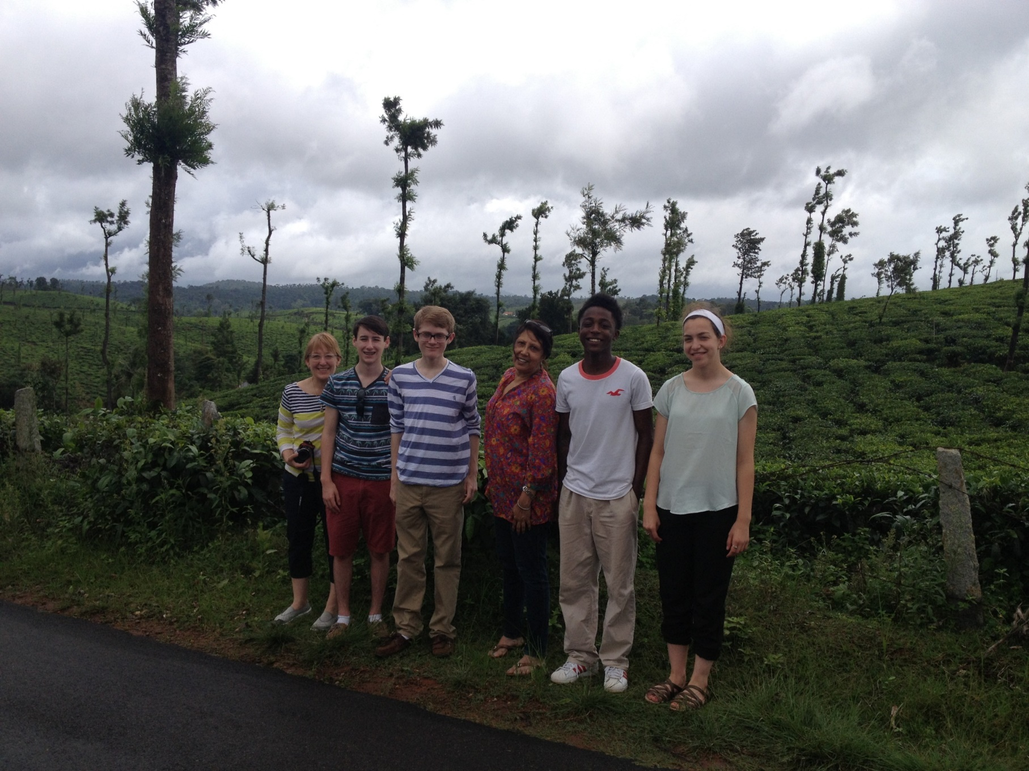
At the Tea plantations

Slide 33
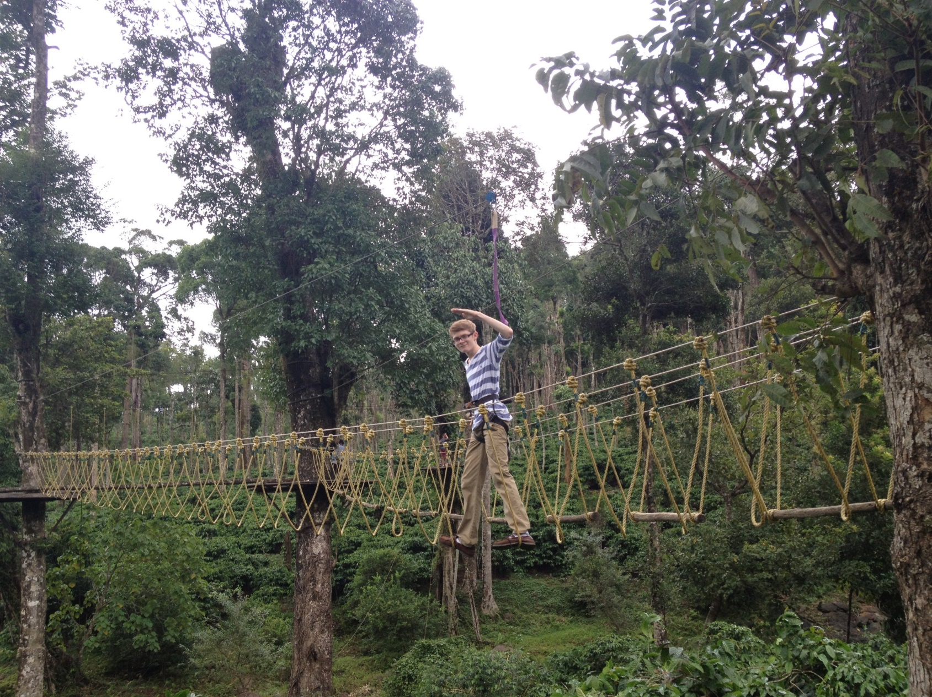
On the Leadership Course above coffee plants

Slide 35
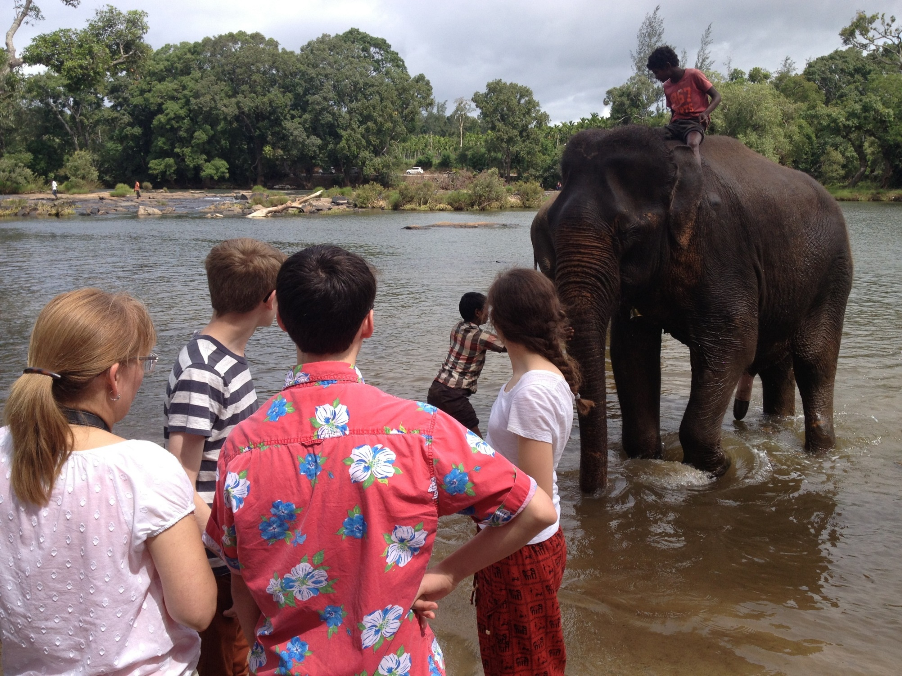
Bath Time for the Elephants

Slide 36
THANK YOU !

